Slide 1


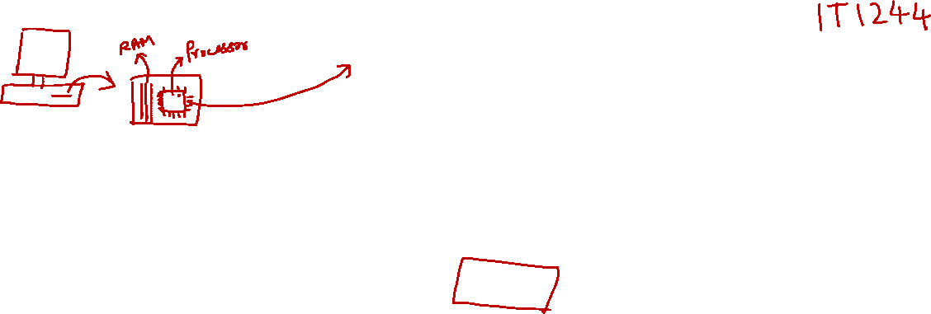
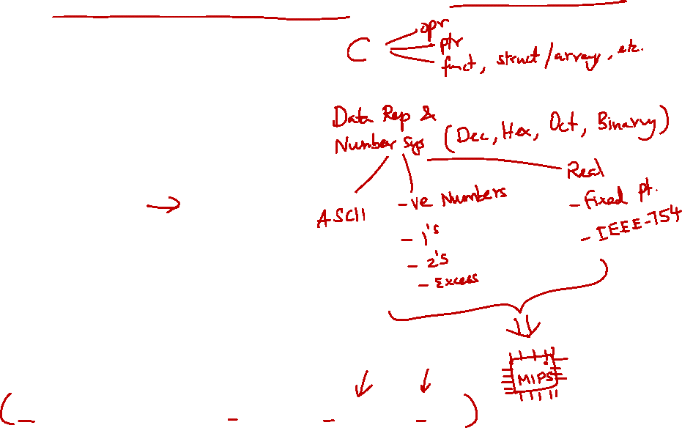
http://www.comp.nus.edu.sg/~cs2100/
Lecture #7
MIPS
Part I: Introduction
Microprocessor without Interlocked Pipelined Stages

Slide 2
Lecture #7: MIPS Part 1: Introduction (1/2)
Instruction Set Architecture
Machine Code vs Assembly Language
Walkthrough
General Purpose Registers
MIPS Assembly Language
5.1 General Instruction Syntax
5.2 Arithmetic Operation: Addition
5.3 Arithmetic Operation: Subtraction
5.4 Complex Expression
5.5 Constant/Immediate Operands
5.6 Register Zero ($0 or $zero)

Slide 3
Lecture #7: MIPS Part 1: Introduction (1/2)
MIPS Assembly Language
5.7 Logical Operations: Overview
5.8 Logical Operations: Shifting
5.9 Logical Operations: Bitwise AND
5.10 Logical Operations: Bitwise OR
5.11 Logical Operations: Bitwise NOR
5.12 Logical Operations: Bitwise XOR
Large Constant: Case Study
MIPS Basic Instructions Checklist

Slide 4
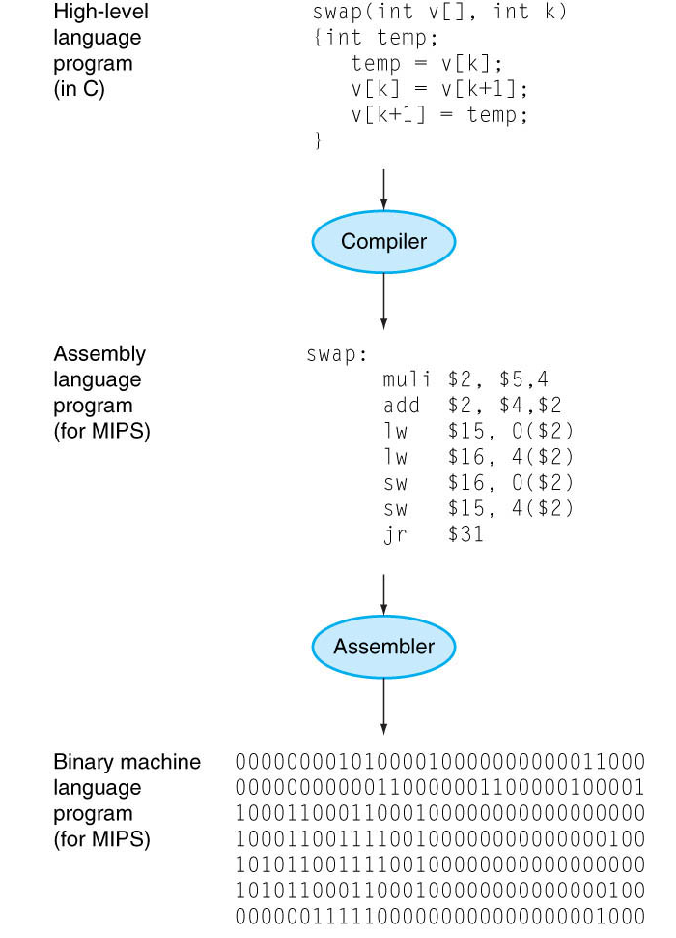
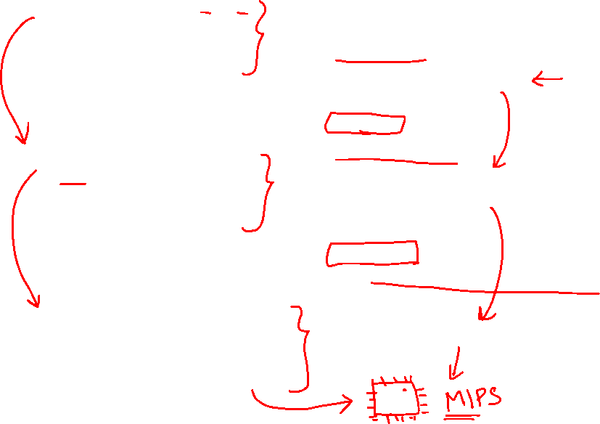
Recap
You write programs in high-level programming languages, e.g., C/C++, Java:
Compiler translates this into assembly language statement:
Assembler translates this statement into machine language instructions that the processor can execute:
A + B
add A, B
1000 1100 1010 0000

Slide 5


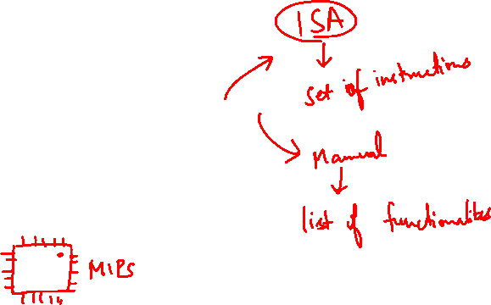
1. Instruction Set Architecture (1/2)
Instruction Set Architecture (ISA):
An abstraction on the interface between the hardware and the low-level software.
Software
(to be translated to the instruction set)
Instruction Set Architecture
Hardware
(implementing the instruction set)

Slide 6
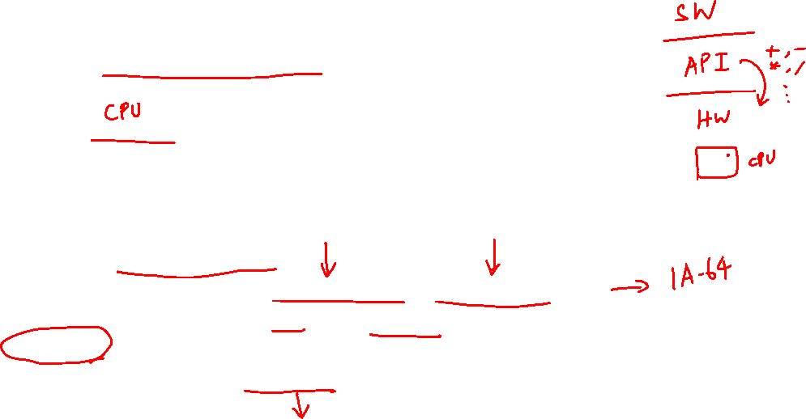
1. Instruction Set Architecture (2/2)
Instruction Set Architecture
Includes everything programmers need to know to make the machine code work correctly
Allows computer designers to talk about functions independently from the hardware that performs them
This abstraction allows many implementations of varying cost and performance to run identical software.
Example: Intel x86/IA-32 ISA has been implemented by a range of processors starting from 80386 (1985) to Pentium 4 (2005)
Other companies such as AMD and Transmeta have implemented IA-32 ISA as well
A program compiled for IA-32 ISA can be executed on any of these implementations

Slide 7
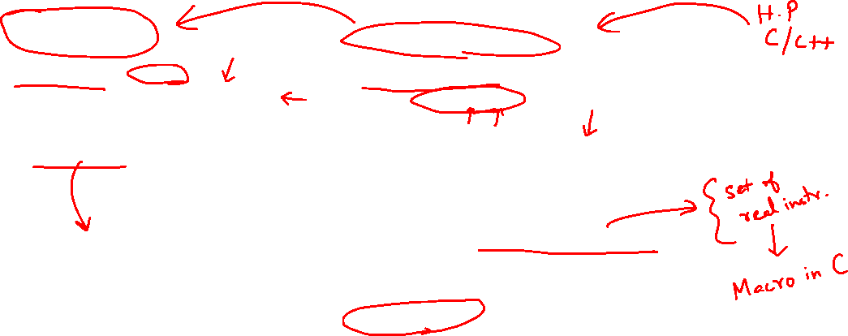
2. Machine Code vs Assembly Language
Machine Code | Assembly Language
Instructions in binary e.g.: 1000 1100 1010 0000 → Add two numbers | Human readable e.g.: add A, B → Add two numbers
Hard and tedious to code | Easier to write than machine code, symbolic version of machine code
1000 1100 1010 0000 ← ASSEMBLER ← add A, B
May also be written in hexadecimal for a more human-readable format | May provide ‘pseudo-instructions’ as syntactic sugar
 | When considering performance, only real instructions are counted
NOTE:
Syntactic "sugar" is basically a translation scheme from a language to the same language (e.g., from C to C or in this case from MIPS to MIPS). The pseudo-instructions are then translated into one or more real instructions.
For example, in MIPS, we have move $rd, $rs being translated into add $rd, $rs, $zero.

Slide 8
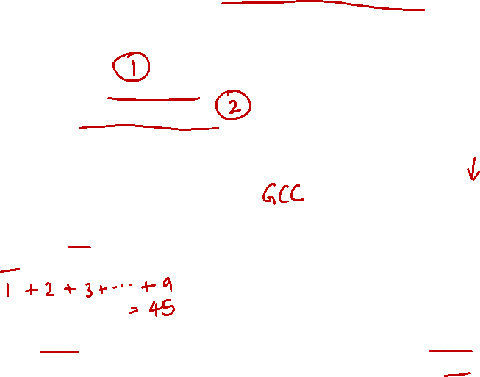
3. Walkthrough: An Example Code (1/15)
Let us take a journey with the execution of a simple code:
Discover the components in a typical computer
Learn the type of instructions required to control the processor
Simplified to highlight the important concepts ☺
// assume res is 0 initially
for (i=1; i<10; i++) {
res = res + i;
}
res ← res + i
i ← i + 1
if i < 10, repeat
compile to
C-like code fragment
“Assembly” Code
NOTE:
Not a real "assembly" language but hopefully instructive enough for our purpose.

Slide 9
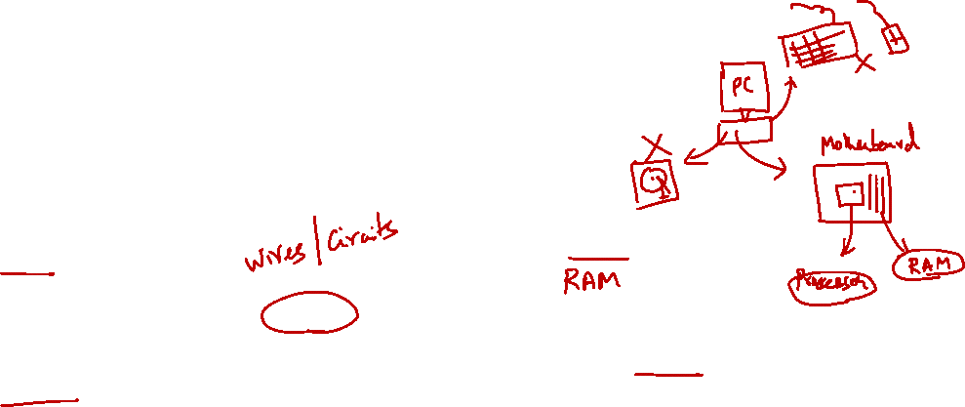
3. Walkthrough: The Components (2/15)
The two major components in a computer
Processor and Memory
Input/Output devices omitted in this example
Processor
Memory
Bus
Storage of code and data
Perform computations
Bridge between the two components
NOTE:
"Bus" is really just a data connector between memory and processor. Memory is typically simply a RAM.

Slide 10
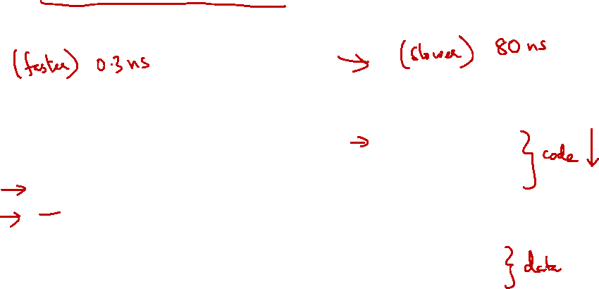
3. Walkthrough: The Code in Action (3/15)
The code and data reside in memory
Transferred into the processor during execution
Processor
Memory
Inst
res ← res + i
Bus
………..
res ← res + i
i ← i + 1
ALU
res+i
if i < 10,
………
i
1
res
0
………..

Slide 11
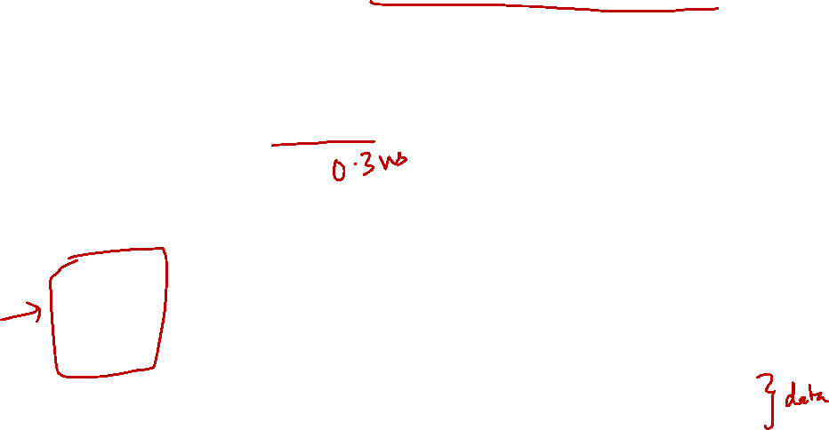
3. Walkthrough: Memory Access is Slow! (4/15)
To avoid frequent access of memory
Provide temporary storage for values in the processor (known as registers)
Processor
Memory
Inst
Bus
………..
res ← res + i
r0
i ← i + 1
r1
ALU
if i < 10,
..
…
………
i
1
res
0
………..

Slide 12
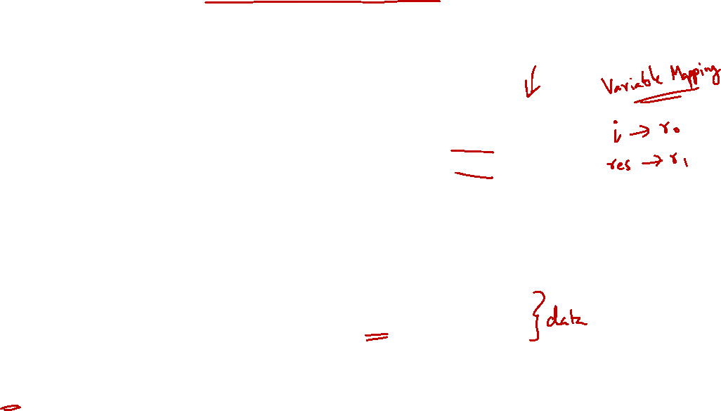
3. Walkthrough: Memory Instruction (5/15)
Need instruction to move data into registers
Also to move data from registers to memory later
Memory
Processor
………..
r0 ← load i
Inst
r0 ← load i
r1 ← load res
Bus
res ← res + i
r0
1
i ← i + 1
r1
ALU
if i < 10,
..
…
………
i
1
Moving data from memory into a register – load
Moving data from a register into memory – store
res
0
………..

Slide 13
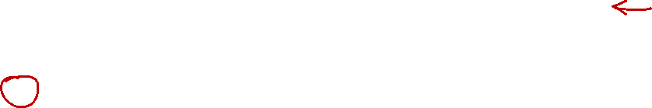
3. Walkthrough: Memory Instruction (6/15)
Need instruction to move data into registers
Also to move data from registers to memory later
Memory
Processor
………..
r0 ← load i
Inst
r1 ← load res
r1 ← load res
Bus
res ← res + i
r0
1
i ← i + 1
r1
0
ALU
if i < 10,
..
…
………
i
1
Moving data from memory into a register – load
Moving data from a register into memory – store
res
0
………..

Slide 14
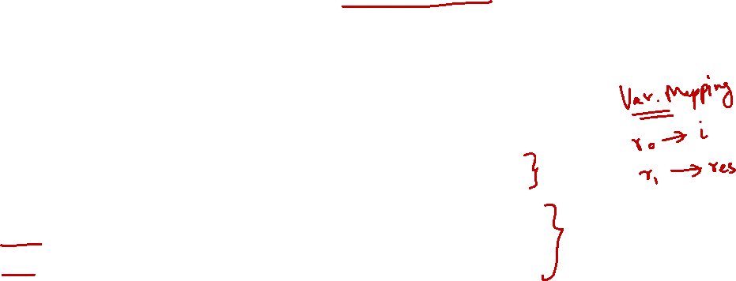
3. Walkthrough: Reg-to-Reg Arithmetic (7/15)
Arithmetic operations can now work directly on registers only (much faster!)
Memory
Processor
………..
r0 ← load i
Inst
r1 ← r1 + r0
r1 ← load res
Bus
r1 ← r1 + r0
r0
1
r0 ← r0 + 1
ALU
if r0 < 10,
r1
0
1
..
…
………
i
1
res
0
………..

Slide 15

3. Walkthrough: Reg-to-Reg Arithmetic (8/15)
Sometimes, arithmetic operation uses a constant value instead of register value
Memory
Processor
………..
r0 ← load i
Inst
r0 ← r0 + 1
r1 ← load res
Bus
r1 ← r1 + r0
r0
2
r0 ← r0 + 1
1
ALU
r1
1
if r0 < 10,
1
..
…
………
i
1
res
0
………..

Slide 16
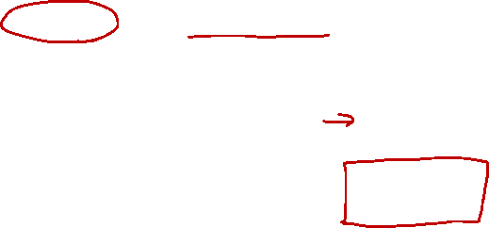
3. Walkthrough: Execution Sequence (9/15)
Instruction is executed sequentially by default
How do we “repeat” or “make a choice”?
Memory
Processor
………..
r0 ← load i
Inst
r1 ← load res
Bus
r1 ← r1 + r0
r0
r0 ← r0 + 1
ALU
if r0 < 10,
r1
..
…
………
i
1
res
0
………..

Slide 17
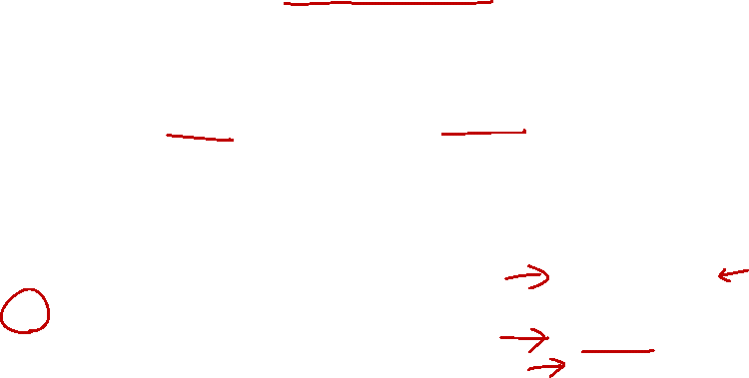
3. Walkthrough: Control Flow (10/15)
We need instructions to change the control flow based on condition:
Repetition (loop) and Selection (if-else) can both be supported
Memory
Processor
………..
r0 ← load i
Inst
if r0 < 10, repeat
r1 ← load res
Bus
r1 ← r1 + r0
r0
2
r0 ← r0 + 1
ALU
if r0 < 10,
r1
1
..
…
………
i
1
res
0
………..

Slide 18

3. Walkthrough: Looping! (11/15)
Since the condition succeeded, execution will repeat from the indicated position
Memory
Processor
………..
r0 ← load i
Inst
r1 ← r1 + r0
r1 ← load res
Bus
r1 ← r1 + r0
r0
2
r0 ← r0 + 1
ALU
if r0 < 10,
r1
1
3
..
…
………
i
1
res
0
………..

Slide 19
3. Walkthrough: Looping! (12/15)
Execution will continue sequentially
Until we see another control flow instruction
Memory
Processor
………..
r0 ← load i
Inst
r0 ← r0 + 1
r1 ← load res
Bus
r1 ← r1 + r0
2
r0 ← r0 + 1
r0
3
ALU
r1
3
if r0 < 10,
1
..
…
………
i
1
res
0
………..

Slide 20

3. Walkthrough: Looping! (13/15)
The three instructions will be repeated until the condition fails
Memory
Processor
………..
r0 ← load i
Inst
if r0 < 10, repeat
r1 ← load res
Bus
r1 ← r1 + r0
r0
10
r0 ← r0 + 1
ALU
if r0 < 10,
r1
45
..
…
………
i
1
res
0
………..

Slide 21

3. Walkthrough: Memory Instruction (14/15)
We can now move back the values from register to their “home” in memory
Similarly for “r1” to “res”
Memory
Processor
………..
r0 ← load i
Inst
i ← store r0
r1 ← load res
Bus
r1 ← r1 + r0
r0
10
r0 ← r0 + 1
ALU
if r0 < 10,
r1
45
..
…
i ← store r0
………
i
1
10
res
0
………..

Slide 22
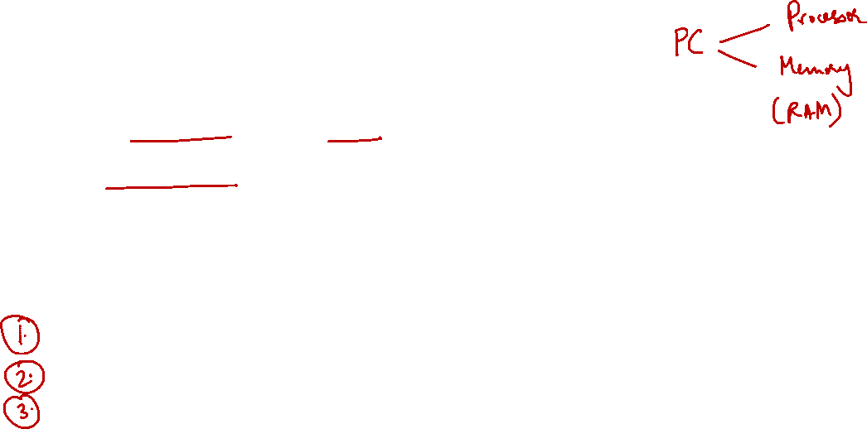
3. Walkthrough: Summary (15/15)
The stored-memory concept:
Both instruction and data are stored in memory
The load-store model:
Limit memory operations and relies on registers for storage during execution
The major types of assembly instruction:
Memory: Move values between memory and registers
Calculation: Arithmetic and other operations
Control flow: Change the sequential execution
NOTE:
A typical assembly code structure is: (1) load, (2) compute, (3) store.
We will assume in this module that we have enough register to store all variables in our program.

Slide 23
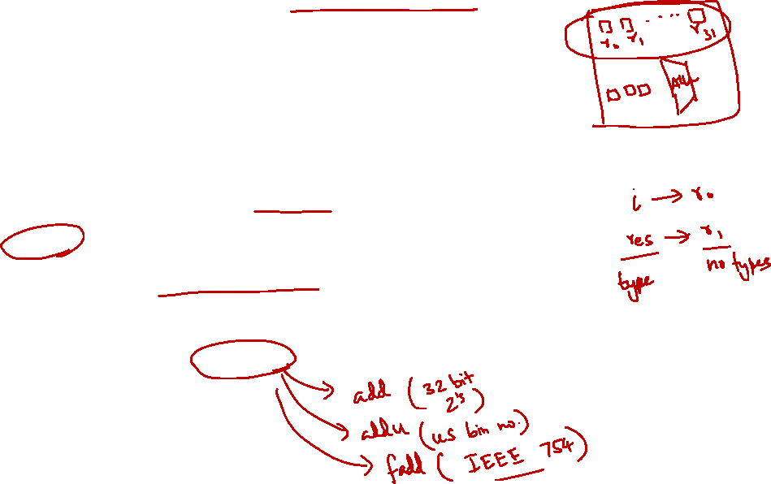
4. General Purpose Registers (1/2)
Fast memories in the processor:
Data are transferred from memory to registers for faster processing
Limited in number:
A typical architecture has 16 to 32 registers
Compiler associates variables in program with registers
Registers have no data type
Unlike program variables!
Machine/Assembly instruction assumes the data stored in the register is of the correct type

Slide 24
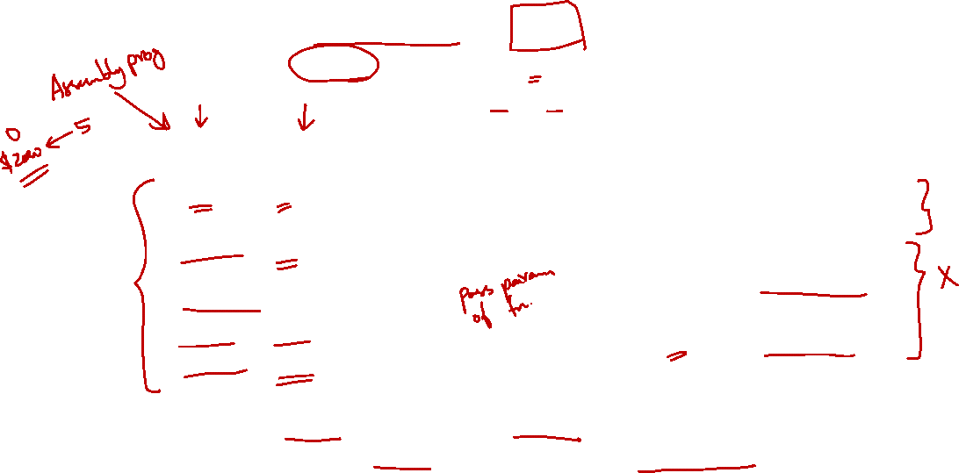
4. General Purpose Registers (2/2)
There are 32 registers in MIPS assembly language:
Can be referred by a number ($0, $1, …, $31) OR
Referred by a name (eg: $a0, $t1)
Name | Register number | Usage
$zero | 0 | Constant value 0
$v0-$v1 | 2-3 | Values for results and expression evaluation
$a0-$a3 | 4-7 | Arguments
$t0-$t7 | 8-15 | Temporaries
$s0-$s7 | 16-23 | Program variables
Name | Register number | Usage
$t8-$t9 | 24-25 | More temporaries
$gp | 28 | Global pointer
$sp | 29 | Stack pointer
$fp | 30 | Frame pointer
$ra | 31 | Return address
$at (register 1) is reserved for the assembler.
$k0-$k1 (registers 26-27) are reserved for the operating system.

Slide 25
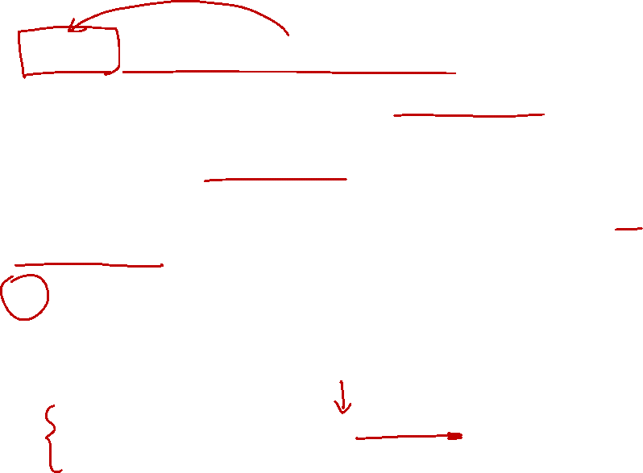
5. MIPS Assembly Language
Each instruction executes a simple command
Usually has a counterpart in high-level programming languages like C/C++, Java etc
Each line of assembly code contains at most 1 instruction
# (hex-sign) is used for comments
Anything from # to end of line is a comment and will be ignored by the assembler
add $t0, $s1, $s2 # $t0 ← $s1 + $s2
sub $s0, $t0, $s3 # $s0 ← $t0 - $s3

Slide 26
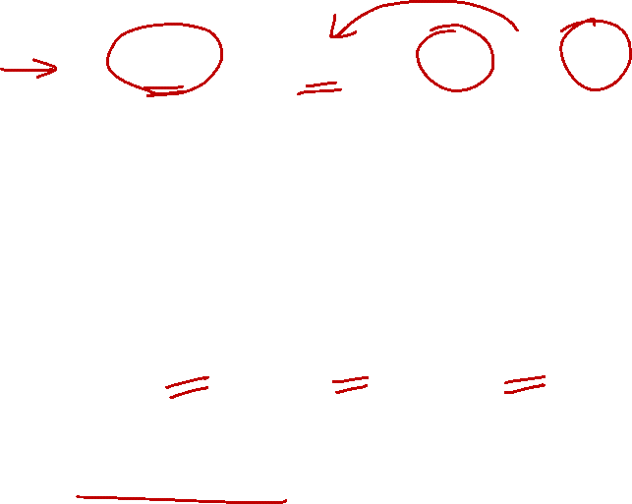
5.1 General Instruction Syntax
add $s0, $s1, $s2
Source 2
Operation (op)
Source 1
Destination
(gets the result)
$s0 = $s1 + $s2
Naturally, most of the MIPS arithmetic/logic operations have three operands: 2 sources and 1 destination

Slide 27
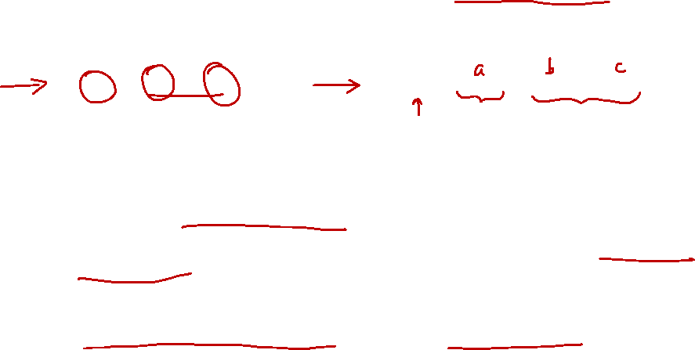
5.2 Arithmetic Operation: Addition
C Statement | MIPS Assembly Code
a = b + c; | add $s0, $s1, $s2
We assume the values of "a", "b" and "c" are loaded into registers "$s0", "$s1" and "$s2"
Known as variable mapping
Actual code to perform the loading will be shown later in memory instruction
Important concept:
MIPS arithmetic operations are mainly register-to-register
NOTE:
The variable-to-register mapping deals with step (1) (i.e., load) and step (3) (i.e., store). All computations are assumed to be in register for this set of instructions. We will talk about load/store in the next lecture.

Slide 28
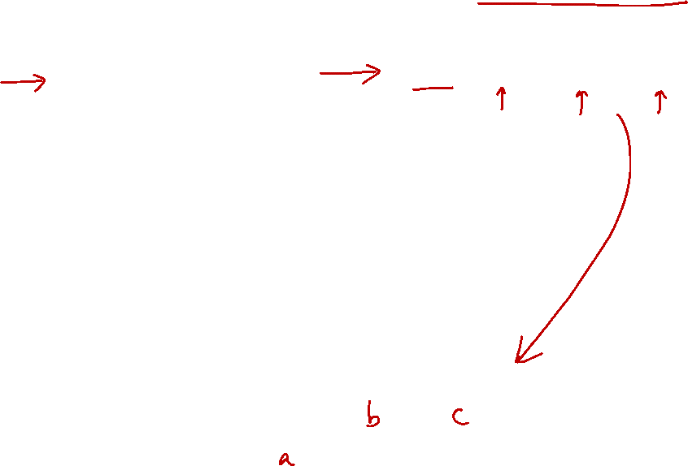
5.3 Arithmetic Operation: Subtraction
C Statement | MIPS Assembly Code
a = b - c; | sub $s0, $s1, $s2 $s0 → variable a $s1 → variable b $s2 → variable c
Positions of $s1 and $s2 (i.e., source1 and source2) are important for subtraction
NOTE:
sub $s0, $s1, $s2
is basically
$s0 = $s1 - $s2

Slide 29
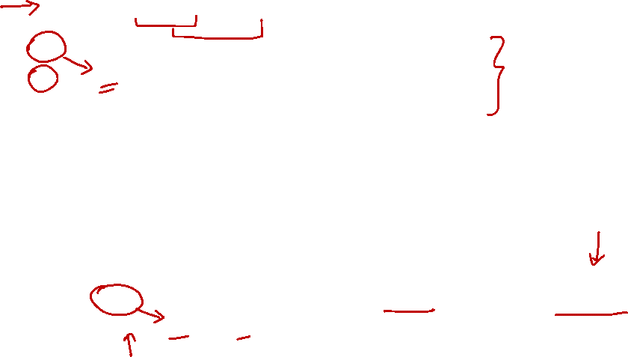
5.4 Complex Expression (1/3)
C Statement | MIPS Assembly Code
a = b + c - d; | ??? ??? ??? $s0 → variable a $s1 → variable b $s2 → variable c $s3 → variable d
t0 = b + c;
a = t0 - d;
A single MIPS instruction can handle at most two source operands
➔ Need to break a complex statement into multiple MIPS instructions
MIPS Assembly Code
add $t0, $s1, $s2 # tmp = b + c sub $s0, $t0, $s3 # a = tmp - d
Use temporary registers $t0 to $t7 for intermediate results

Slide 30

5.4 Complex Expression: Example (2/3)
C Statement | Variable Mappings
f = (g + h) – (i + j); | $s0 → variable f $s1 → variable g $s2 → variable h $s3 → variable i $s4 → variable j
t0 = g + h;
t1 = i + j;
f = t0 – t1;
Break it up into multiple instructions
Use two temporary registers $t0, $t1
add $t0, $s1, $s2 # tmp0 = g + h
add $t1, $s3, $s4 # tmp1 = i + j
sub $s0, $t0, $t1 # f = tmp0 – tmp1

Slide 31
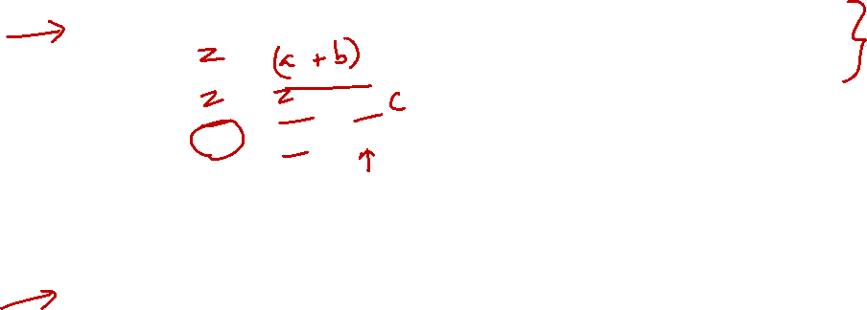
5.4 Complex Expression: Exercise (3/3)
C Statement | Variable Mappings
z = a + b + c + d; | $s0 → variable a $s1 → variable b $s2 → variable c $s3 → variable d $s4 → variable z
z = a + b;
z = z + c;
z = z + d;
add $s4, $s0, $s1
add $s4, $s4, $s2
add $s4, $s4, $s3
C Statement | Variable Mappings
z = (a – b) + c; | $s0 → variable a $s1 → variable b $s2 → variable c $s3 → variable z
z = a - b;
z = z + c;
sub $s3, $s0, $s1
add $s3, $s3, $s2


Slide 32
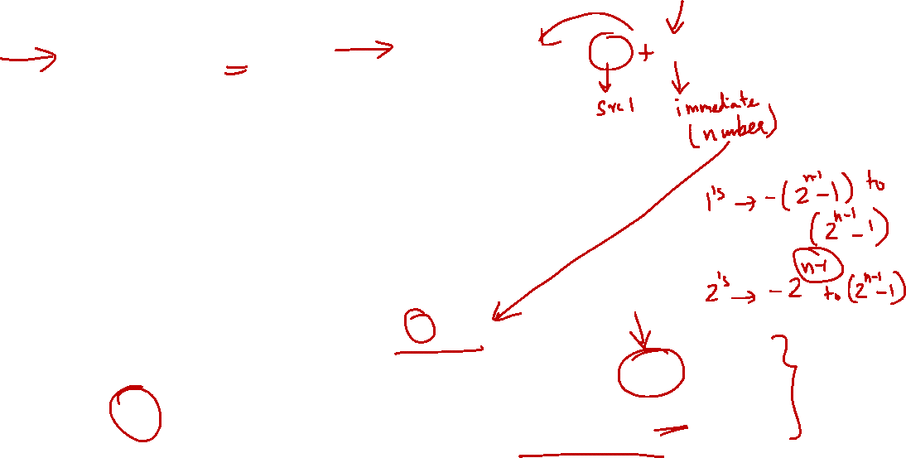
5.5 Constant/Immediate Operands
C Statement | MIPS Assembly Code
a = a + 4; | addi $s0, $s0, 4
Immediate values are numerical constants
Frequently used in operations
MIPS supplies a set of operations specially for them
“Add immediate” (addi)
Syntax is similar to add instruction; but source2 is a constant instead of register
The constant ranges from [-2¹⁵ to 2¹⁵-1]
Can you guess what number system is used?
There’s no subi. Why?
Answer: 16-bit 2s complement number system
Answer: Use addi with negative constant


Slide 33
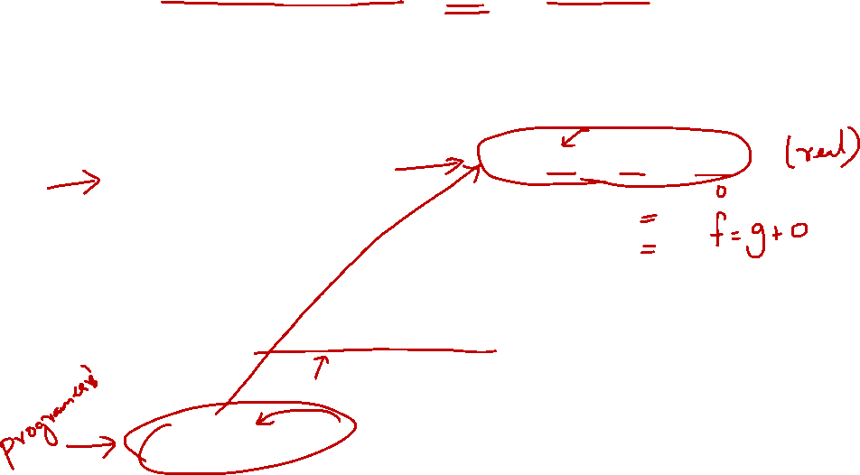
5.6 Register Zero ($0 or $zero)
The number zero (0), appears very often in code
Provide register zero ($0 or $zero) which always have the value 0
C Statement | MIPS Assembly Code
f = g; | add $s0, $s1, $zero $s0 → variable f $s1 → variable g
f = g + 0
The above assignment is so common that MIPS has an equivalent pseudo-instruction (move):
MIPS Assembly Code
move $s0, $s1
Pseudo-Instruction
"Fake" instruction that gets translated to corresponding MIPS instruction(s). Provided for convenience in coding only.

Slide 34
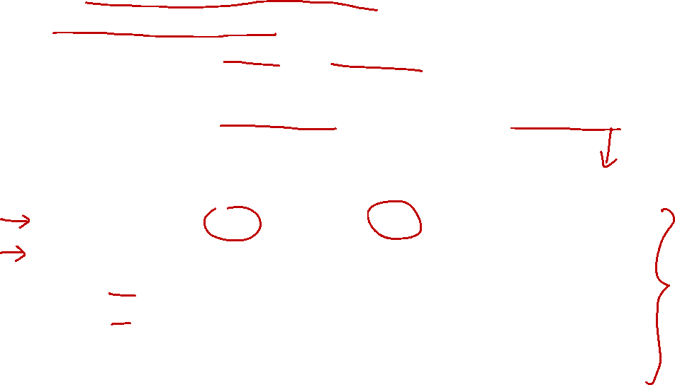
5.7 Logical Operations: Overview (1/2)
Arithmetic instructions view the content of a register as a single quantity (signed or unsigned integer)
New perspective:
View register as 32 raw bits rather than as a single 32-bit number
➔ Possible to operate on individual bits or bytes within a word
Logical operation | C operator | Java operator | MIPS instruction
Shift Left | << | << | sll
Shift right | >>** | >>, >>> | srl
Bitwise AND | & | & | and, andi
Bitwise OR | | | | | or, ori
Bitwise NOT* | ~ | ~ | nor
Bitwise XOR | ^ | ^ | xor
*with some tricks
**this is "arithmetic" shift in both GCC and Clang (compiler dependent)

Slide 35
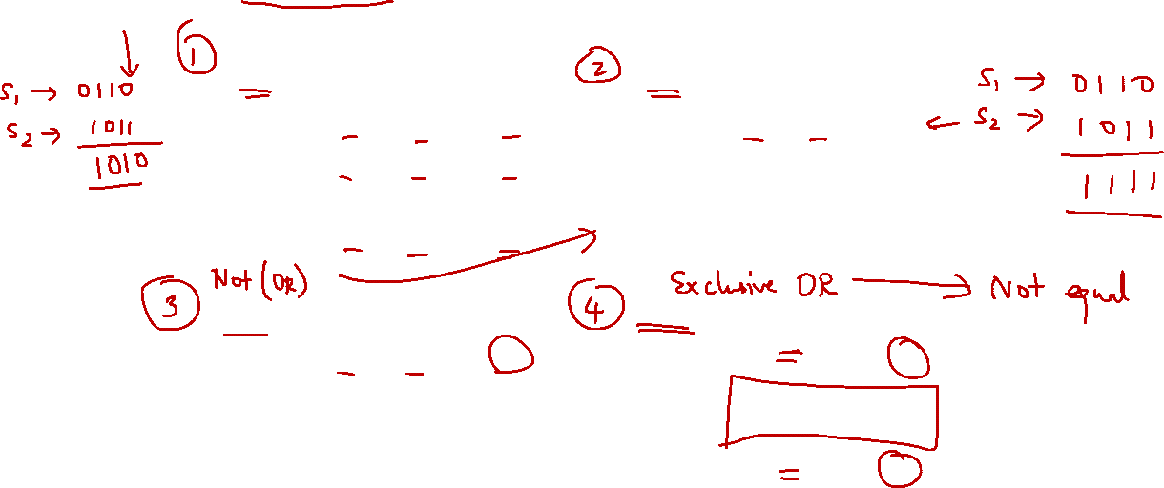
5.7 Logical Operations: Overview (2/2)
Truth tables of logical operations
0 represents false; 1 represents true
AND
a | b | a AND b
0 | 0 | 0
0 | 1 | 0
1 | 0 | 0
1 | 1 | 1
OR
a | b | a OR b
0 | 0 | 0
0 | 1 | 1
1 | 0 | 1
1 | 1 | 1
NOTE:
1 if BOTH a and b are 1. Otherwise 0.
NOTE:
0 if BOTH a and b are 0. Otherwise 1.
NOR
a | b | a NOR b
0 | 0 | 1
0 | 1 | 0
1 | 0 | 0
1 | 1 | 0
XOR
a | b | a XOR b
0 | 0 | 0
0 | 1 | 1
1 | 0 | 1
1 | 1 | 0
NOTE:
1 if BOTH a and b are 0. Otherwise 0.
NOTE:
1 if a is NOT the same as b.

Slide 36
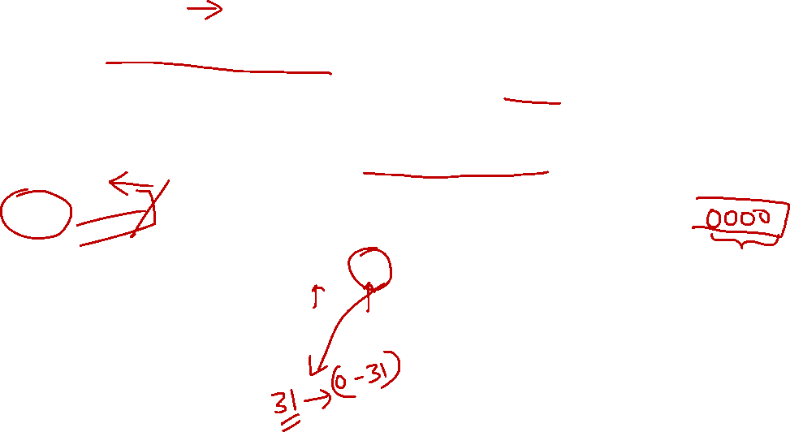
5.8 Logical Operations: Shifting (1/2)
Move all the bits in a word to the left by a number of positions; fill the emptied positions with zeroes.
Opcode: sll (shift left logical)
E.g. Shift bits in $s0 to the left by 4 positions
$s0
1011 1000 0000 0000 0000 0000 0000 1001
sll $t2, $s0, 4 # $t2 = $s0<<4
$t2
1000 0000 0000 0000 0000 0000 1001 0000
NOTE:
The emptied positions are filled with 0s

Slide 37
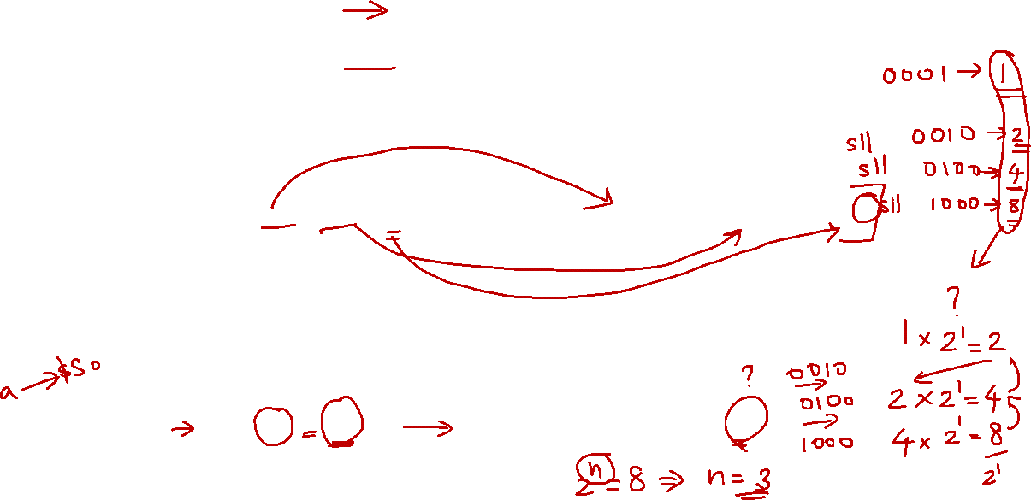
5.8 Logical Operations: Shifting (2/2)
Shifts right and fills emptied positions with zeroes.
Opcode: srl (shift right logical)
What is the equivalent math operations for shifting left/right n bits? Answer:
Shifting is faster than multiplication/division
Good compiler translates such multiplication/division into shift instructions
Multiply/divide by 2^{n}
C Statement | MIPS Assembly Code
a = a * 8; | sll $s0, $s0, 3
NOTE:
Since 8 = 2³, we can use a = a << 3.


Slide 38
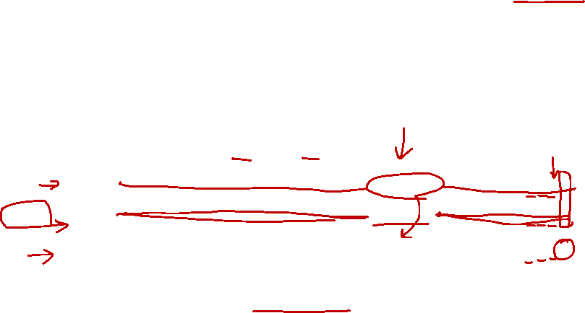
5.9 Logical Operations: Bitwise AND
Bitwise operation that leaves a 1 only if both the bits of the operands are 1
Opcode: and ( bitwise AND )
E.g.: and $t0, $t1, $t2
$t1
0110 0011 0010 1111 0000 1101 0101 1001
mask
$t2
0000 0000 0000 0000 0011 1100 0000 0000
$t0
0000 0000 0000 0000 0000 1100 0000 0000
and can be used for masking operation:
Place 0s into the positions to be ignored ➔ bits will turn into 0s
Place 1s for interested positions ➔ bits will remain the same as the original.
NOTE:
Bit-mask is setting the irrelevant part to 0 (i.e., masked).

Slide 39

5.9 Exercise: Bitwise AND
We are interested in the last 12 bits of the word in register $t1. Result to be stored in $t0.
Q: What’s the mask to use?
$t1
0000 1001 1100 0011 0101 1101 1001 1100
mask
0000 0000 0000 0000 0000 1111 1111 1111
$t0
0000 0000 0000 0000 0000 1101 1001 1100
NOTE:
Keep last 12-bits as 1. This is equivalent to andi $t1, $t1, 0xFFF.
Notes:
The and instruction has an immediate version, andi


Slide 40
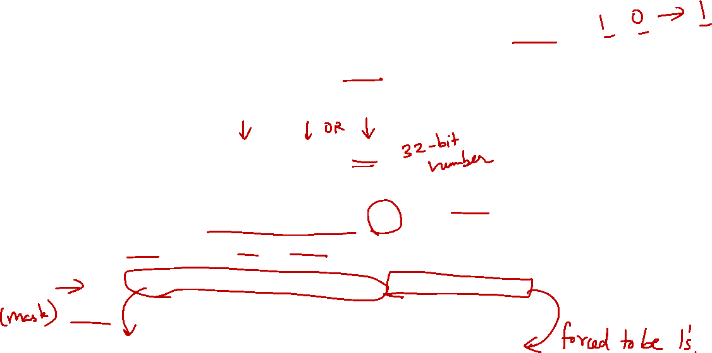
5.10 Logical Operations: Bitwise OR
Bitwise operation that places a 1 in the result if either operand bit is 1
Example: or $t0, $t1, $t2
Opcode: or ( bitwise OR )
The or instruction has an immediate version ori
Can be used to force certain bits to 1s
E.g.: ori $t0, $t1, 0xFFF
$t1
0000 1001 1100 0011 0101 1101 1001 1100
0xFFF
0000 0000 0000 0000 0000 1111 1111 1111
$t0
0000 1001 1100 0011 0101 1111 1111 1111
For ori $t0, $t1, 0xFFFF will the upper 16-bits be all 0s or all 1s?

Answer: all 0s (in other words, this is not sign-extended)

Slide 41
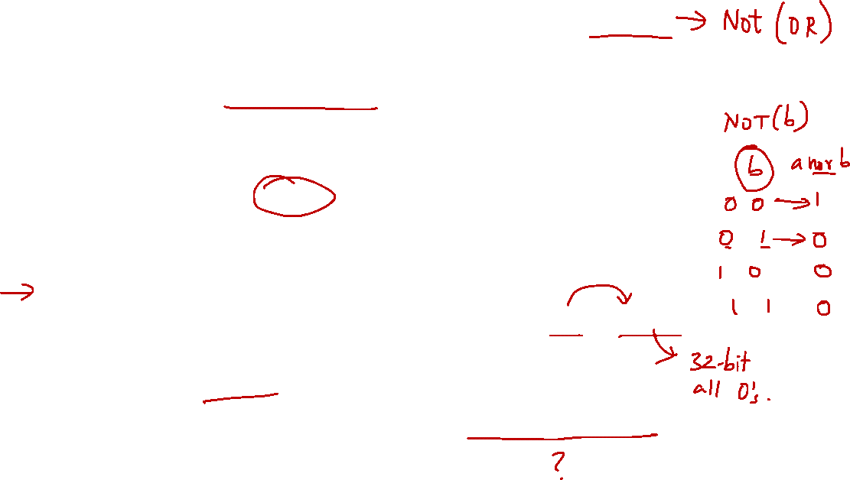
5.11 Logical Operations: Bitwise NOR
Strange fact 1:
There is no NOT instruction in MIPS to toggle the bits (1 → 0, 0 → 1)
However, a NOR instruction is provided:
Example: nor $t0, $t1, $t2
a | b | a NOR b
0 | 0 | 1
0 | 1 | 0
1 | 0 | 0
1 | 1 | 0
Opcode: nor ( bitwise NOR )
Question: How do we get a NOT operation?
Question: Why do you think is the reason for not providing a NOT instruction?
nor $t0, $t0, $zero
One of design principles: Keep the instruction set small.


Slide 42
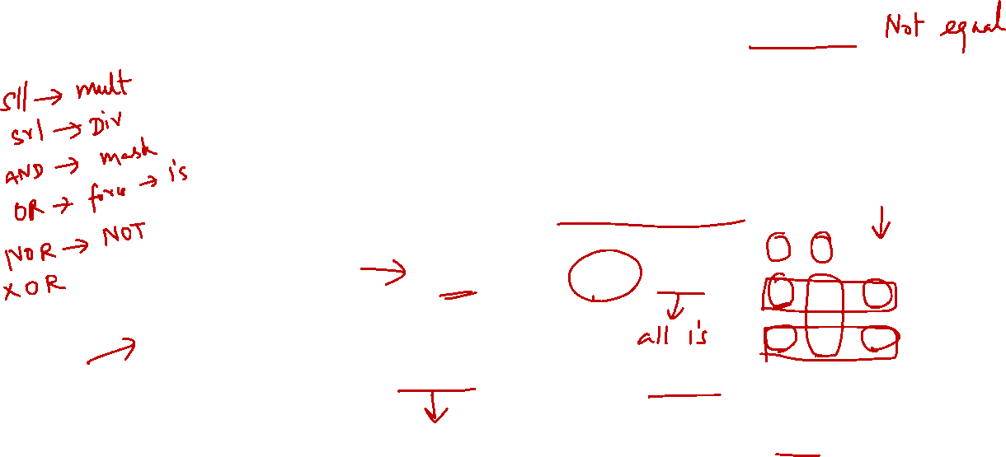
5.12 Logical Operations: Bitwise XOR
Example: xor $t0, $t1, $t2
Opcode: xor ( bitwise XOR )
Question: Can we also get NOT operation from XOR?
Strange Fact 2:
There is no NORI, but there is XORI in MIPS
Why?
Yes, let $t2 contain all 1s.
xor $t0, $t0, $t2
a | b | a XOR b
0 | 0 | 0
0 | 1 | 1
1 | 0 | 1
1 | 1 | 0
NOTE:
A possible reason is that there is not much need for NORI. So there is no reason to add this capability to keep the processor design simple.


Slide 43
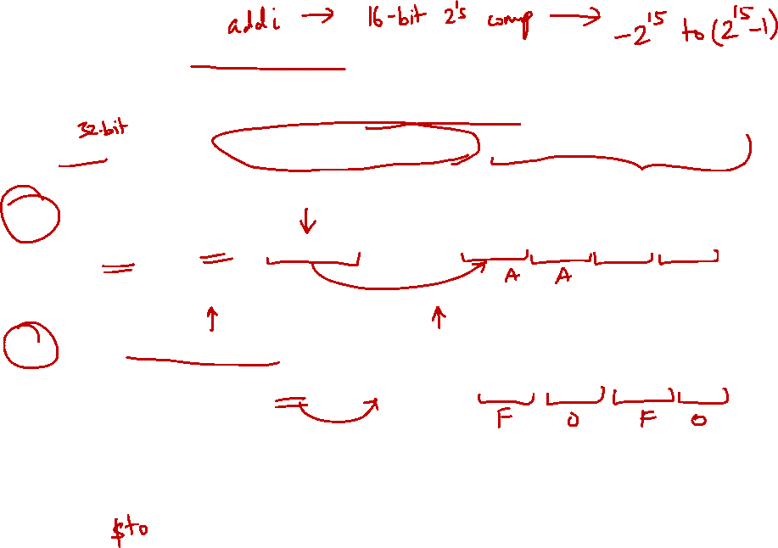
6. Large Constant: Case Study
Question: How to load a 32-bit constant into a register? e.g 10101010 10101010 11110000 11110000
Use “load upper immediate” (lui) to set the upper 16-bit:
lui $t0, 0xAAAA #1010101010101010
Lower-order bits filled with zeros.
1010101010101010
0000000000000000
Use “or immediate” (ori) to set the lower-order bits:
ori $t0, $t0, 0xF0F0 #1111000011110000
Higher-order bits filled with zeros.
1010101010101010
0000000000000000
ori
0000000000000000
1111000011110000
1010101010101010
1111000011110000

Slide 44
7. MIPS Basic Instructions Checklist
Operation | Opcode in MIPS | Meaning
Addition | add $rd, $rs, $rt | $rd = $rs + $rt
 | addi $rt, $rs, C16_{2s} | $rt = $rs + C16_{2s}
Subtraction | sub $rd, $rs, $rt | $rd = $rs - $rt
Shift left logical | sll $rd, $rt, C5 | $rd = $rt << C5
Shift right logical | srl $rd, $rt, C5 | $rd = $rt >> C5
AND bitwise | and $rd, $rs, $rt | $rd = $rs & $rt
 | andi $rt, $rs, C16 | $rt = $rs & C16
OR bitwise | or $rd, $rs, $rt | $rd = $rs | $rt
 | ori $rt, $rs, C16 | $rt = $rs | C16
NOR bitwise | nor $rd, $rs, $rt | $rd = $rs ↓ $rt
XOR bitwise | xor $rd, $rs, $rt | $rd = $rs ^ $rt
 | xori $rt, $rs, C16 | $rt = $rs ^ C16
C5 is [0 to 2⁵-1] C16_{2s} is [-2¹⁵ to 2¹⁵-1] C16 is a 16-bit pattern

Slide 45
Additional Notes
sll and srl only need 5 bits (i.e., C5) because shifting by 32-bits empties the register (i.e., set to 0).
C16 are NOT sign-extended.
A possible reason is because it is used for logical operations which typically concern with the bits as it is (plus, it is treated as raw bits and not number).
C16_{2s} are sign-extended.
Otherwise, addi will not work properly as the processor can only work with 32-bits.

Slide 46
Additional Notes
You may wonder why we learn C to learn MIPS. The reason is simply because in C, we control the memory. So, the C code match closely to the corresponding MIPS code.
All other language are too far removed from the underlying memory structure to be useful UNLESS we are only using a subset of those language.
But in C, we are forced to use these simpler subset.
This will hopefully make more sense once you start "compiling" from C to MIPS on your own.

Slide 47
7. MIPS Basic Instructions Checklist
Operation | Opcode in MIPS | Immediate Version (if applicable)
Addition | add $s0, $s1, $s2 | addi $s0, $s1, C16_{2s} C16_{2s} is [-2¹⁵ to 2¹⁵-1]
Subtraction | sub $s0, $s1, $s2
Shift left logical | sll $s0, $s1, C5 C5 is [0 to 2⁵-1]
Shift right logical | srl $s0, $s1, C5
AND bitwise | and $s0, $s1, $s2 | andi $s0, $s1, C16 C16 is a 16-bit pattern
OR bitwise | or $s0, $s1, $s2 | ori $s0, $s1, C16
NOR bitwise | nor $s0, $s1, $s2
XOR bitwise | xor $s0, $s1, $s2 | xori $s0, $s1, C16

Slide 48
End of File

